Slide 1
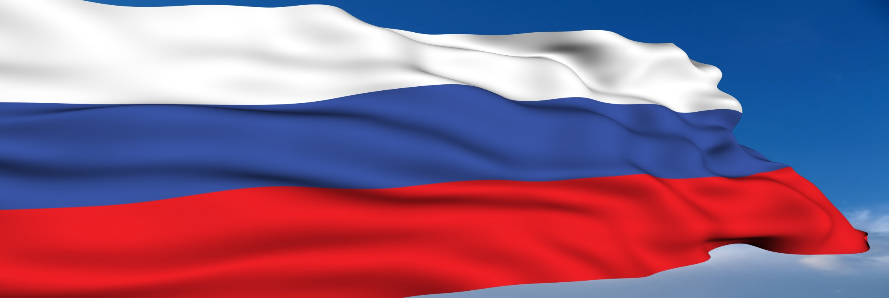



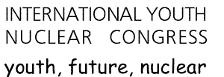
YOUTH BRANCH OF RUSSIAN NUCLEAR SOCIETY
INTERNATIONAL YOUTH NUCLEAR CONGRESS – 2016
September 19-24, Ekaterinburg, Russia

Slide 2
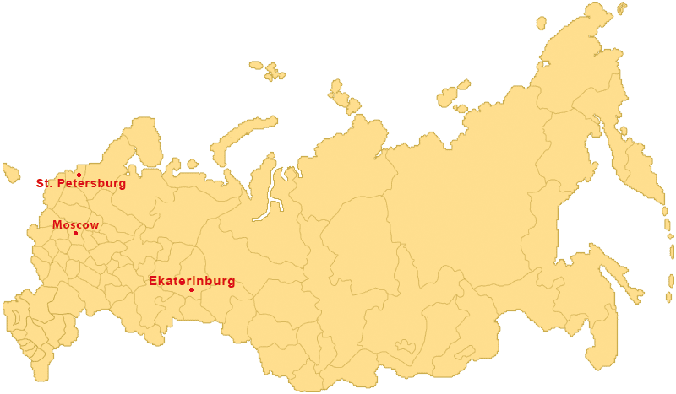
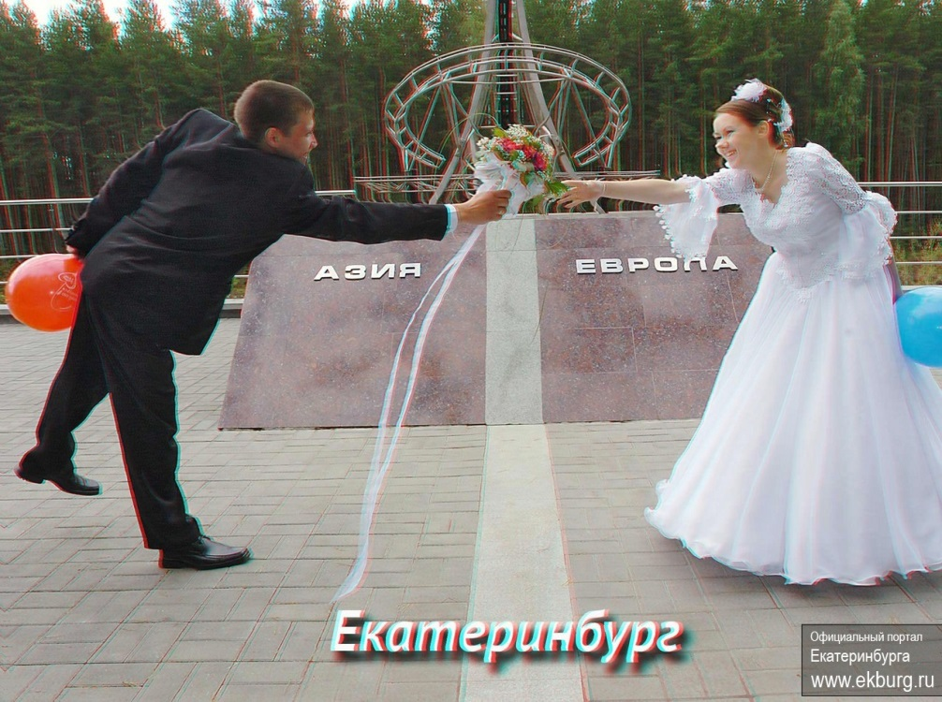
Proposed host city
IYNC2016
Notes:
Yekaterinburg is the fourth-largest city in Russia and the administrative center of Sverdlovsk Oblast, located in Asia (the middle of the Eurasian continent, on the border of Europe and Asia).
Yekaterinburg was founded in 1723 and named after Tsar Peter the Great's wife Catherine I (Yekaterina).

Slide 3
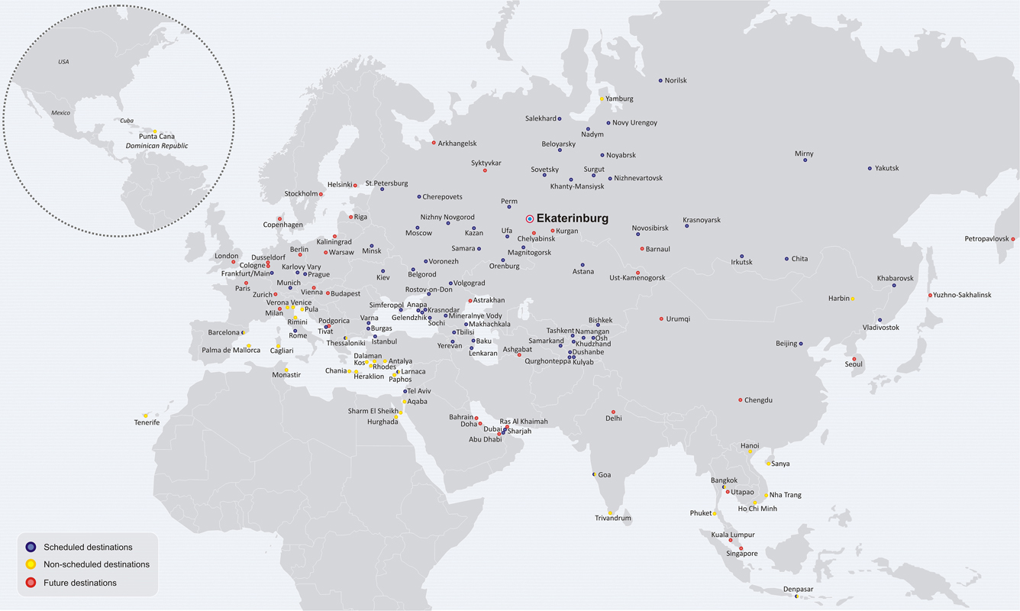
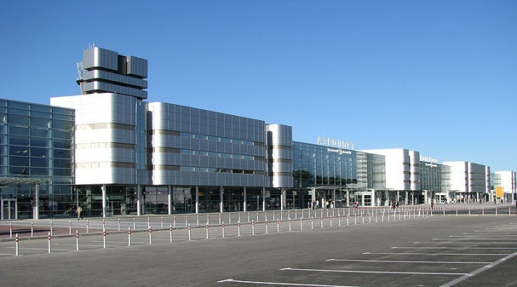
Koltsovo Airport, Ekaterinburg
IYNC2016
Notes:
Ekaterinburg Koltsovo International Airport is Russia’s largest regional airport. Over 30 Russian and foreign airlines connect Ekaterinburg with more than 80 cities of the world.
There are near 20 flights from Moscow each day. Ticket coast is near 100 euro.
For transfer from Koltsovo International Airport to Ekaterinburg you could:
Bus shuttle (approximately 30 min for travel),
Train (approximately 30 min for travel),
Taxi

Slide 4
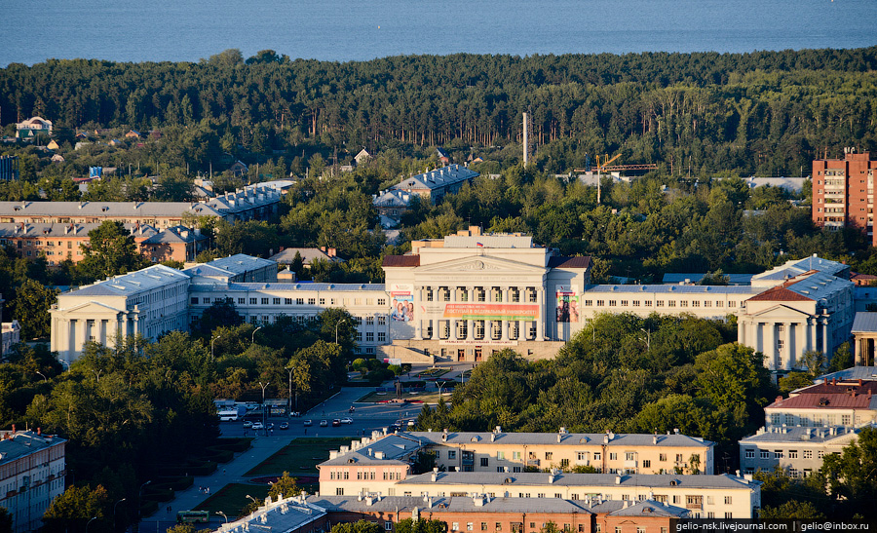
Proposed host city
IYNC2016
Notes:
Ekaterinburg have enough different in range hotels which are placed in center of the city. Standard room cost is near 80 euro per night. You could use follow link for more information:
www.hotel-okt.ru
www.richmondhotel.ru
www.ekb-vesta.narod.ru
www.booking.com

Slide 5
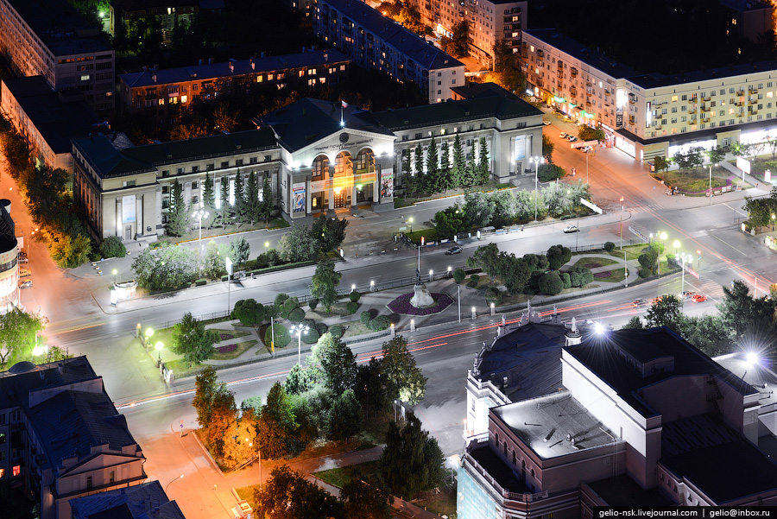
Proposed host city
IYNC2016

Slide 6
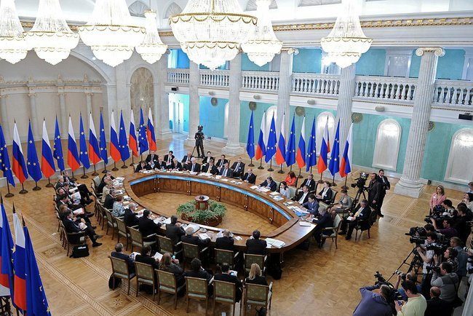
Ekaterinburg hosting experience
June 3 — 4, 2013 Russia-EU summit.
IYNC2016
Notes:
8—9 October 2003 Russian-German Intergovernmental Consultations
June 15, 2009 A meeting of the Shanghai Cooperation Organisation Council of Heads of State took place in Yekaterinburg
June 16, 2009 First BRIC Group Summit (Dmitry Medvedev met with Prime Minister of India Manmohan Singh).

Slide 7
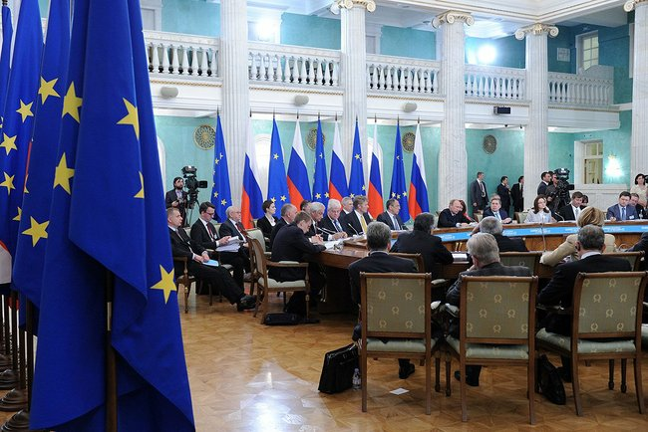
Ekaterinburg hosting experience
June 3 — 4, 2013 Russia-EU summit.
IYNC2016
Notes:
8—9 October 2003 Russian-German Intergovernmental Consultations
June 15, 2009 A meeting of the Shanghai Cooperation Organisation Council of Heads of State took place in Yekaterinburg
June 16, 2009 First BRIC Group Summit (Dmitry Medvedev met with Prime Minister of India Manmohan Singh).

Slide 8
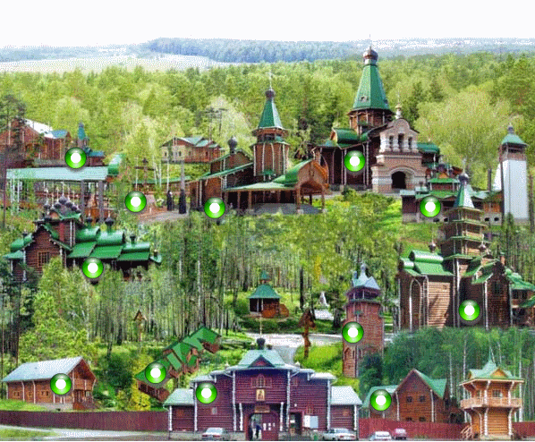
Cultural program
IYNC2016
Notes:
Visit to geographical border between European and Asian parts. This geographical is near Ekaterinburg and placed in Ural mountains. Commemorative photo.
Tours around Ekaterinburg
Special Events
Cultural event include banquet and concert program. Place is determined.

Slide 9
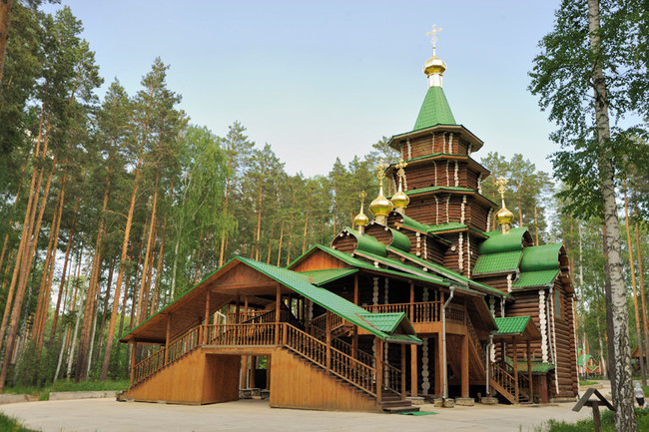
Cultural program
IYNC2016
Notes:
Visit to geographical border between European and Asian parts. This geographical is near Ekaterinburg and placed in Ural mountains. Commemorative photo.
Tours around Ekaterinburg
Special Events
Cultural event include banquet and concert program. Place is determined.

Slide 10
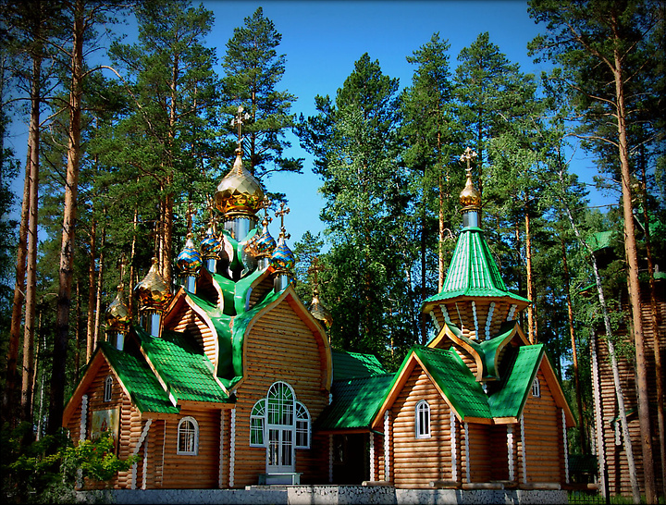
Cultural program
IYNC2016
Notes:
Visit to geographical border between European and Asian parts. This geographical is near Ekaterinburg and placed in Ural mountains. Commemorative photo.
Tours around Ekaterinburg
Special Events
Cultural event include banquet and concert program. Place is determined.

Slide 11
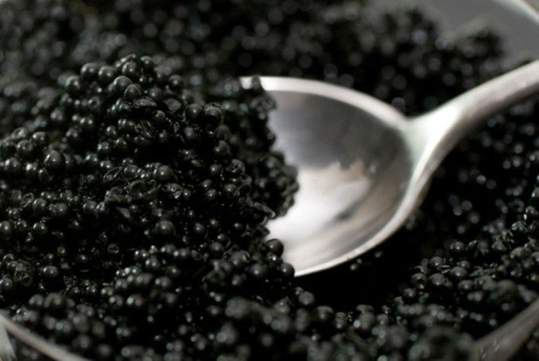
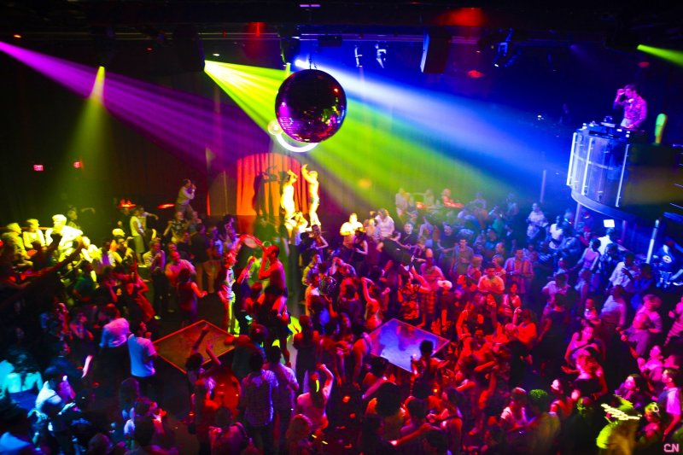
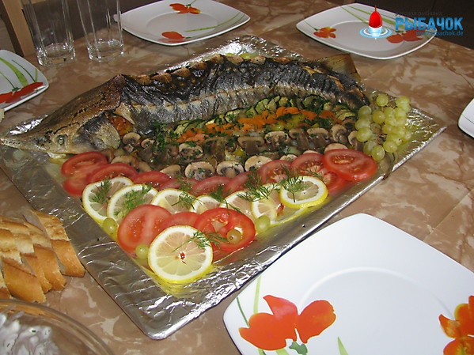
Cultural program
IYNC2016
Notes:
Visit to geographical border between European and Asian parts. This geographical is near Ekaterinburg and placed in Ural mountains. Commemorative photo.
Tours around Ekaterinburg
Special Events
Cultural event include banquet and concert program. Place is determined.

Slide 12
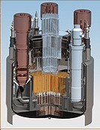
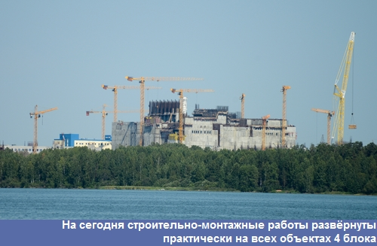
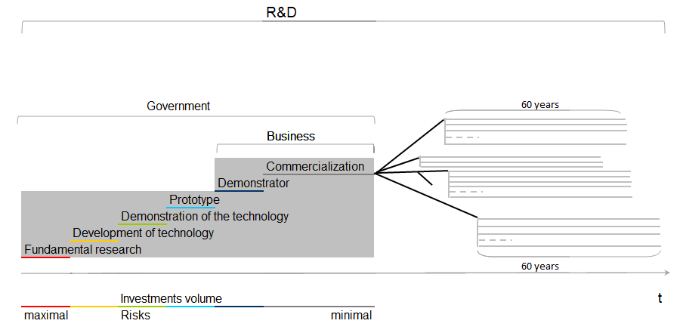
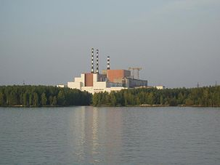
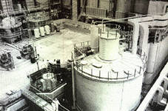
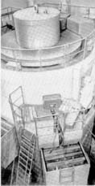
Fast Reactor Commercialization in Russia
project
BN-1200
BN-800
BN-600
2013-
BN-350
BR-5&10
1980-p.t.
1972-1999
1959-2002
IYNC2016

Slide 13
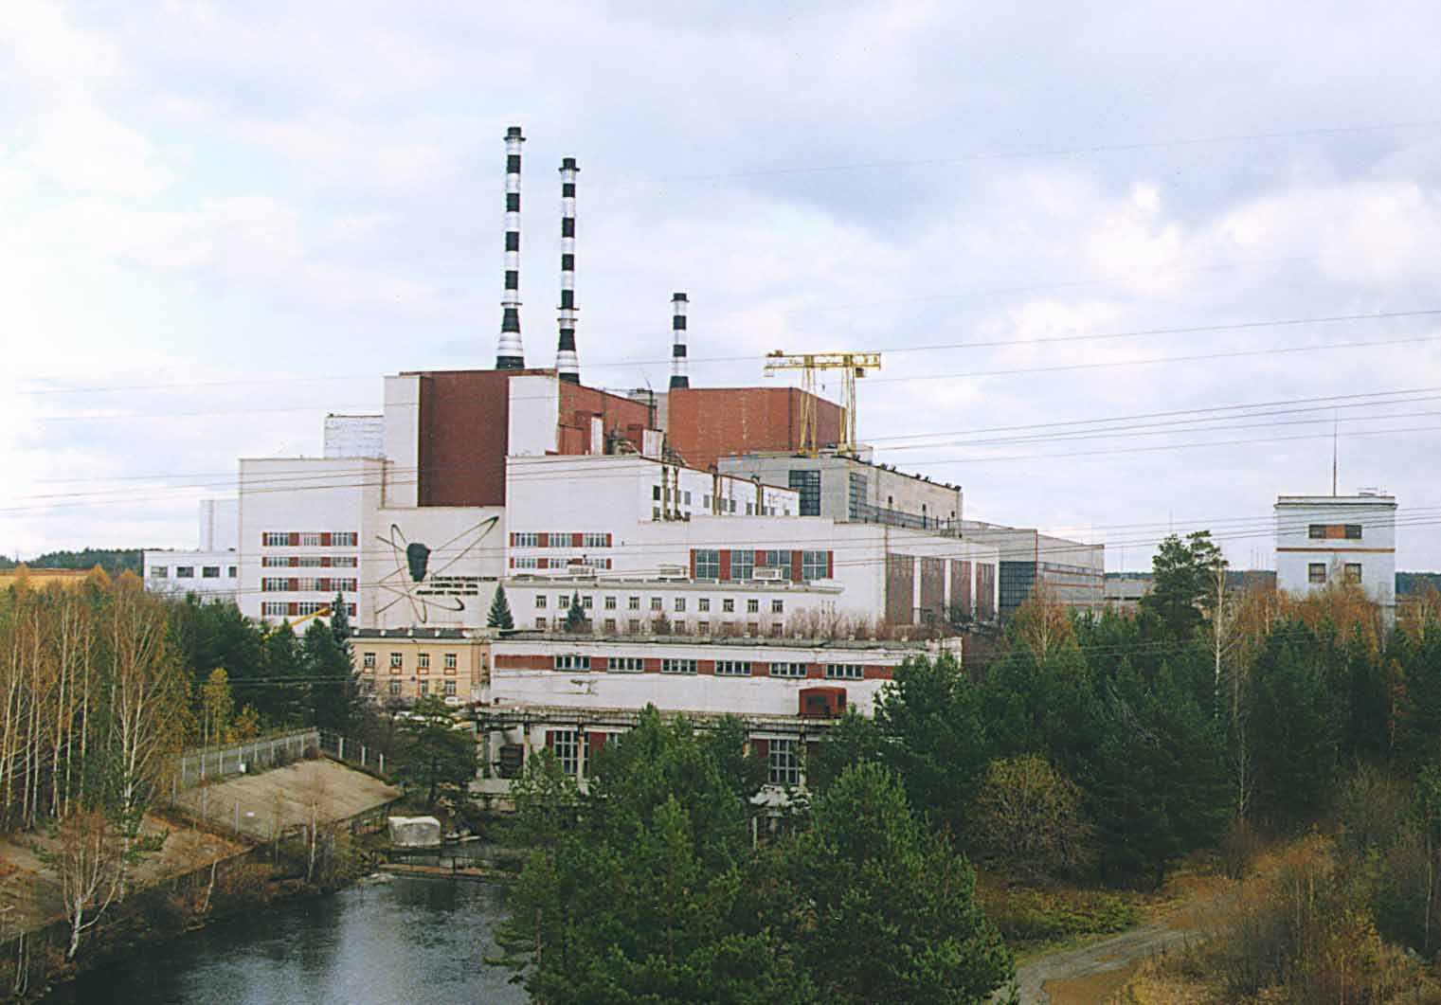
Technical Tours
BN-600 picture
IYNC2016
Notes:
There are many places in Ekaterinburg for organization technical tours. The most interesting are follow:
Visit to Beloyarskaya NPP. At Beloyarskaya NPP operate single in world unique fast reactor with sodium coolant BN-600 (MWe) and to two graphite reactors (AMB-100 and AMB-200) are under decommissioning.
At the moment at Beloyarskaya NPP are going physical start-up of fast reactor BN-800.
Beloyarskaya NPP is placed near Ekateriburg and there are all needed infrastructure for organization of technical tour.
JSC Institute of reactor materials. This Institute is unique Scientific Center of Rosatom. This Center has modern equipment for scientific research
SNIIHimMash in Ekaterinburg (one of the oldest engineering centre of Rosatom engineering division)
Sightseeing tour at the University

Slide 14
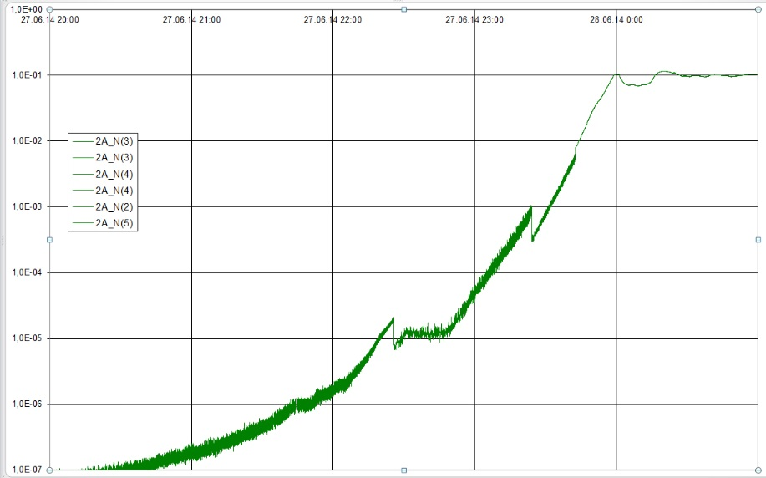
BN-800 first critically

Slide 15
Nuclear Energy System /Energy Chain
Need for development of reliable and suistainable NE in Russia based on multi-component structure of nuclear power.
Resources
Front_End
Secondary
Back_End
~
Enrichment plant
Fabrication VVER&
AdVVER fuel
VVER, AVVER (RUS)
VVER SF, AVVER SF
(RUS)
Nat. U
Conver-sion U
~
LWR Reprocessing
plant
AVVER (Country 1,2)
AVVER SF
(Country 1,2)
Fabrication RBMK
fuel
~
RBMK SF
(RUS)
RBMK
(RUS)
Pu
~
FR_K0
(RUS)
FR_K0
SF
~
Fabricatin FR Fuels
FR_K1
(RUS)
FR_K1
SF
FR Reprocessing
plant
Dep U
~
Pu Reserve
FR_K2
(RUS)
FR_K2
SF
~
(our legacy)
FR_K3
(RUS)
FR_K3
SF
IYNC2016
Notes:
We have a Pu reserve in Storages, this is a military legacy. We will use it to start our fast reactor units.
15

Slide 16
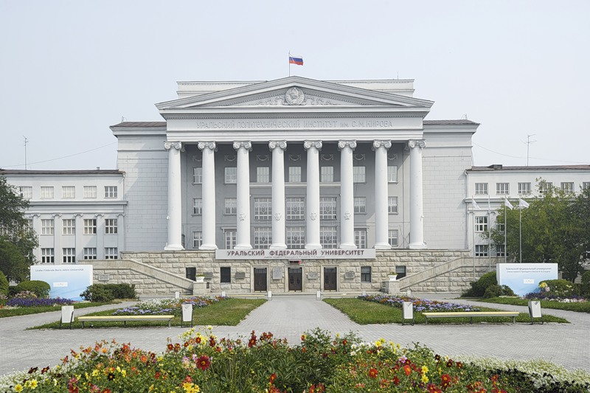
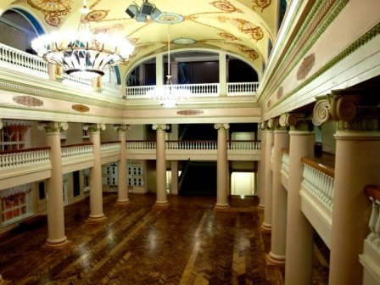
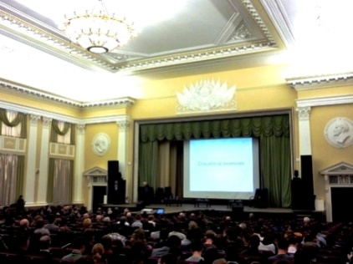
First Venue – the basic place
The University includes 17 institutes offering about 350 degree programs at different levels. The total number of students at UrFU exceeds 50,000. The University has a highly reputable "nuclear" sector of education and science.
Ural Federal University
IYNC2016
Notes:
Ural Federal University (UrFU) is one of the top ranked scientific centers in Russia carrying out research in natural, technical, social sciences, humanities and economics. a.
At University there are several conference halls (biggest hall at max.700 persons). There are banquet hall and all needed infrastructure for the conference.

Slide 17
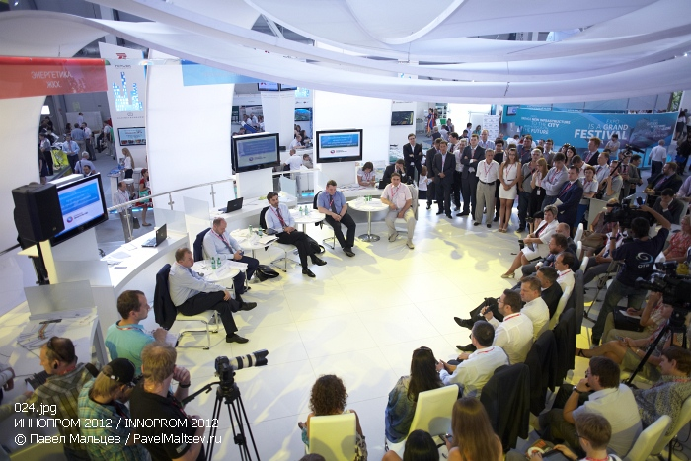
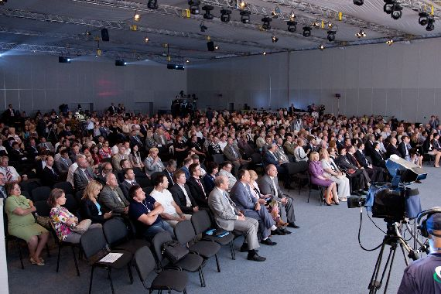
Second Venue – alternative place
International Exhibition Center Ekaterinburg-EXPO offers a unique opportunity for large conventions.
Ekaterinburg – Expo
The Great Congress Hall (1200 persons), banquet hall (300 persons),
5 conference rooms (up to 150 persons each).
IYNC2016
Notes:
International exhibition center Ekaterinburg-EXPO is biggest exhibition center of the Ural and one of the largest and most modern exhibition centers in Russia.
Ekaterinburg-EXPO is just 20 minutes drive from the center of Ekaterinburg in the immediate vicinity of the airport Koltsovo.

Slide 18
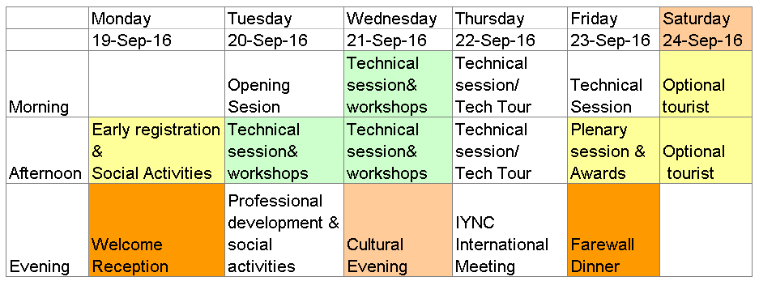
Technical program
IYNC2016
Notes:
Ekaterinburg is big student city and organization IYNC-2016 in this city could integrate new student generation to the global nuclear power infrastructure and popularization nuclear energy.
Beloyarskaya NPP is unique place with operate single in world fast reactor BN-600 so it is also best place for discussion of close fuel cycle aspects.

Slide 19
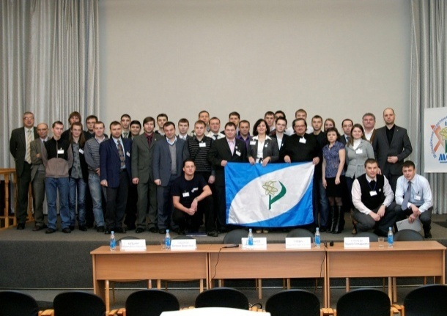
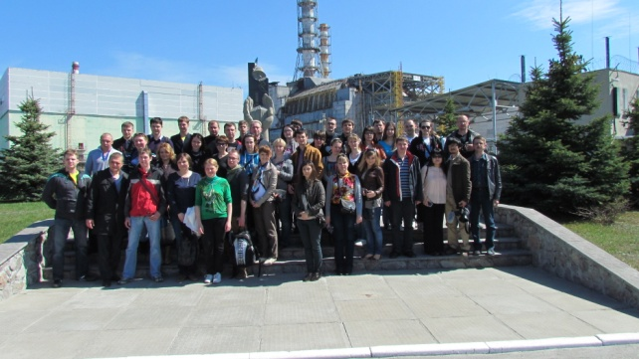
YOUTH BRANCH OF RUSSIAN NUCLEAR SOCIETY
The Youth department of Nuclear Society of Russia (NSR YD) was created in 1995.
It played a leading role in IYNC creation.
IYNC2016
Notes:
The Youth department of Nuclear Society of Russia (NSR YD) was created in 1995. First conference of Russian YGN was organized in Obninsk.
At this moment NSR YD combine near 500 of young engineers, scientists and post graduate students.
The most significant actions this year are:
— Organization and participation in conference devoted to “25 anniversary of Nuclear Society of Russia”
— Organization and participation in conference devoted to 60-th start-up anniversary of First in World Nuclear Power Plant in Obninsk. Approximately participations are 600 members.
— Organization of 19-th annual scientific conference of NSR YD

Slide 20
Local organizing committee
Pavel Fedorov
Chief of NSR YD Board, co-ordinator in field of Nuclear Energy.
Pavel graduated Moscow research nuclear University “Mephy”. Pavel works at Kurskaya NPP in the capacity of deputy of exploitation technical support department head.
Ivan Tsarapkin
Executive secretary.
Ivan graduated Obninsk department of Moscow research nuclear University “Mephy”.
Ivan works at Federal State Unitary Enterprise “State Scientific Center of the Russian Federation – Institute for Physics and Power Engineering named after A. I. Leypunsky” in the capacity of technical support department head.
Andrei Rusinkevich
- co-ordinator in field of science.
Andrei graduated Moscow Aviation Institute and work now in National Research Centre "Kurchatov Institute" by laboratory head.
Alexander Zhukov
co-ordinator in field of international cooperation of NSR YD.
Alexander graduated Obninsk department of Moscow research nuclear University “Mephy”.
Works now at Federal State Unitary Enterprise “State Scientific Center of the Russian Federation – Institute for Physics and Power Engineering named after A. I. Leypunsky” in the capacity of engineer-operator of fast critical facility.
IYNC2016

Slide 21
Egor Oreshkin
Co-ordinator in field of nuclear industry.
Egor graduated Tomsk polytechnic University.
Egor is engineer in State Engeneering Center of the Russian Federation which are placed in Zheleznogorsk.
Alexei Bochkarev
Co-ordinator in field of education (including students).
Alexei graduated Moscow research nuclear University “Mephy” and work now in Mephy by researcher.
Michail Berba
- co-ordinator in field of science.
- Co-ordinator with former active of Russian YGN.
Michail graduated Irkutsk State Linguistic University and work now at The Joint Stock Company “Production Association “Electrochemical Plant” by specialist at department of public relations
Eugeniy Churkin
co-ordinator with youth organization.
President of International association of young nuclear specialists.
Eugeniy graduated Obninsk department of Moscow research nuclear University “Mephy”.
Eugeniy is Obninsk department of Moscow research nuclear University “Mephy” head deputy at social-educational work.
Eugeniy Sidirov
Information Co-ordinator of Russian YGN.
Eugeniy graduated Obninsk department of Moscow research nuclear University “Mephy”.
Eugeniy is deputy of informational department head of the Russian trade Union of nuclear energy and industry.
Viktoriia Klimova
Leader of Ural organization committee.
Viktoria graduated Ural state technical university.
Works now in UrFU at Department of Nuclear Power Plants and Renewables Responsibilities by senior lecturer at courses: Informatics, Numerical simulation of physical processes.
IYNC2016

Slide 22
Budget
 | Cost, $ | Comment
Registration fee | 120 000 | 300 participants х 400 $
Venue
Venue Rental | 10 000 | Reginal sponsor
Audia-Video Rental | 6 000
Simultaneous interpreter | 6 000
File of participant | 17 000 | Book of abstracts (hardcopy), information flyer, program, pen, magnith, souvenir, USB flash drive
Catering | 80 000
Special events
Cultural event | 17 000
Farewell dinner | 17 000
IYNC games | 3 000
Technical tour to Zarechniy (Beloyarskaya NPP)
Transport | 3 000 | Regional sponsor
Catering | 4 500
IYNC Office
Computers, printers,photocopier | 7 000
Office rental | 1 500 | Regional sponsor
Other expences
Bank account fee | 600
Post office box fee | 600
Photographer | 2 000
Photo print | 1 500
The expenses of the preliminary stage | 8 500
Income | 120 000
Expense | 185 200
Sponsor's expense | 100 000
Amount of profit | 35 000
IYNC2016

Slide 23

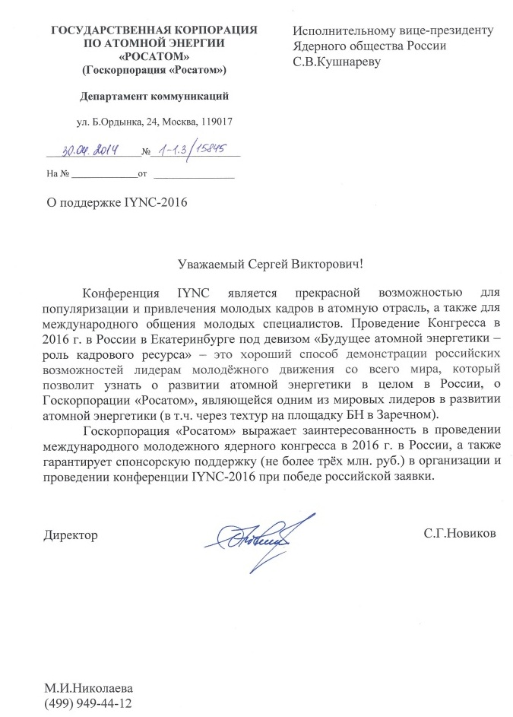





Sponsorship
IYNC2016

Slide 24
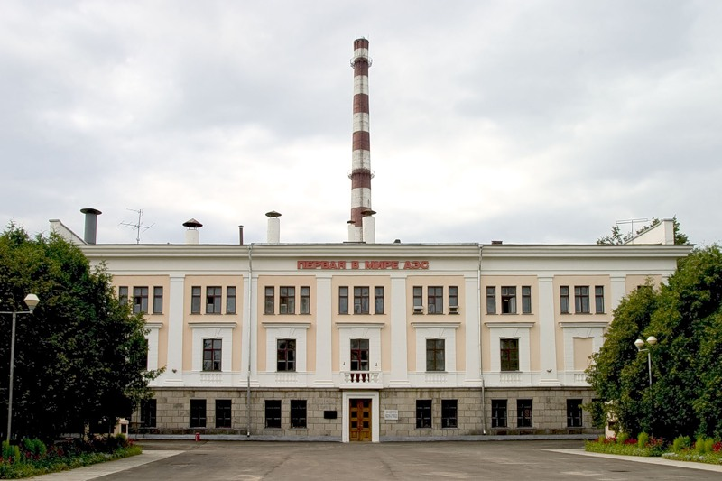
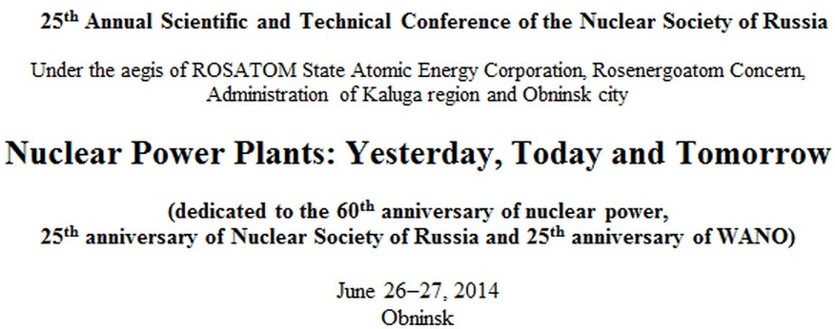
60 Year of First in World Nuclear Power Plant
Nuclear power plant was put into operation on June 27, 1954. Its construction was done in just 3 years. Basic engineering solutions have been developed by the design Bureau headed by N.A. Dollezhal. In parallel there was the formation and training of the first operational team of the First NPP. The building of the NPP - 3 storey building, designed in the style of "Stalin Empire style". Opposite the building of the CHP, which was located turbine is the world's First NPP. Currently, it is recognized that the world's First NPP constructed in Obninsk, as was made to synchronize with a electricity net.

Slide 25
Thank you!

